Slide 1
UNIVERSITY OF IBADAN
Distance Learning Centre | Department of Computer Science
Machine Learning Model for
Predicting House Rent Prices in Ibadan
A Data-Driven Approach for Real Estate Valuation
Presented by: Rotimi Israel Taye (E047849)
Supervisor: Mr. O. A. Abiola
Academic Session: 2024 – 2025

Slide 2
Presentation Outline
01
05
Background & Problem Statement
Data Preprocessing & Analysis
02
06
Related Works
System Interface Screenshots
03
07
Aim & Objectives
Model Evaluation Results
04
08
Methodology & System Design
Conclusion & Recommendations

Slide 3
Background & Problem Statement
The Challenge
Why This Study?
Inconsistent house rent pricing by agents
→ Ibadan's growing population increases housing demand
Lack of data-driven valuation tools
→ Most existing ML studies focus on developed countries
Manual methods are subjective & time-consuming
→ Limited studies address rent prediction in Ibadan
Absence of intelligent rent prediction systems
→ Need for a transparent, interpretable model

Slide 4
Aim & Objectives
AIM
To develop an accurate, data-driven Linear Regression model for predicting rental housing prices in Ibadan, Nigeria, using comprehensive preprocessing and rigorous k-fold cross-validation.
Specific Objectives
1
Collect and preprocess housing data (cleaning, encoding, feature scaling)
2
Develop a Linear Regression ML model using relevant housing features
3
Evaluate model performance using MAE, MSE, RMSE, R², and K-Fold Cross-Validation

Slide 5
Methodology
1
Data Collection
4
Model Training
Agent data + secondary sources (Kaggle, social media)
80% training / 20% testing split
2
Data Preprocessing
5
K-Fold Validation
Cleaning, missing values, encoding, StandardScaler
5-fold cross-validation for robustness
3
Model Development
6
Deployment
Linear Regression: y = β₀ + β₁x₁ + ... + βₙxₙ + ε
Streamlit web application for user interaction

Slide 6
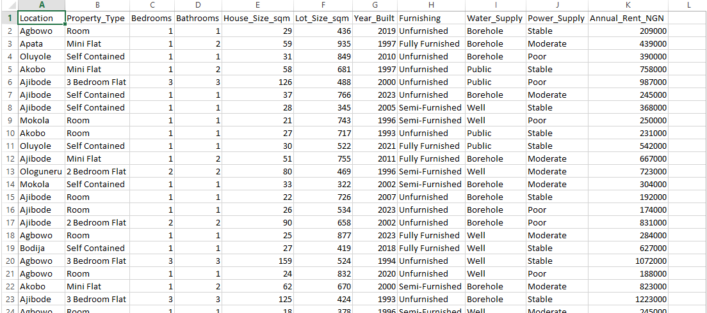
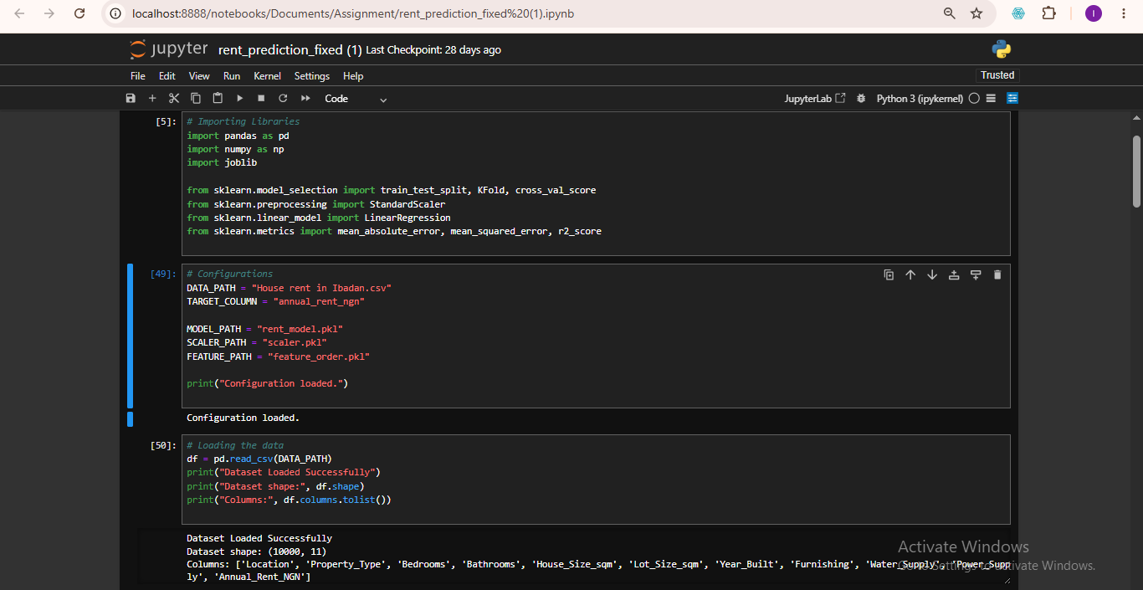
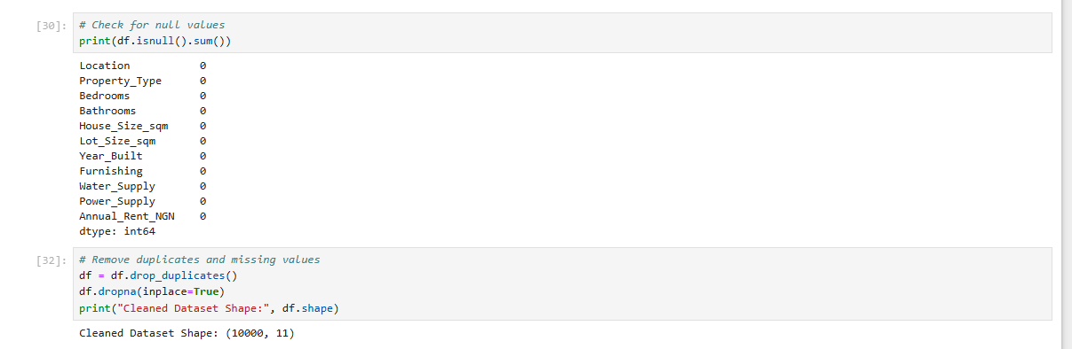
Data Preprocessing & Analysis – Dataset & Cleaning
Fig. 4.1 – Dataset Used in Training the Model (10,000 records × 11 features)
Fig. 4.2 – Loading the Dataset
Fig. 4.2 – Checking for Duplicates & Missing Values

Slide 7
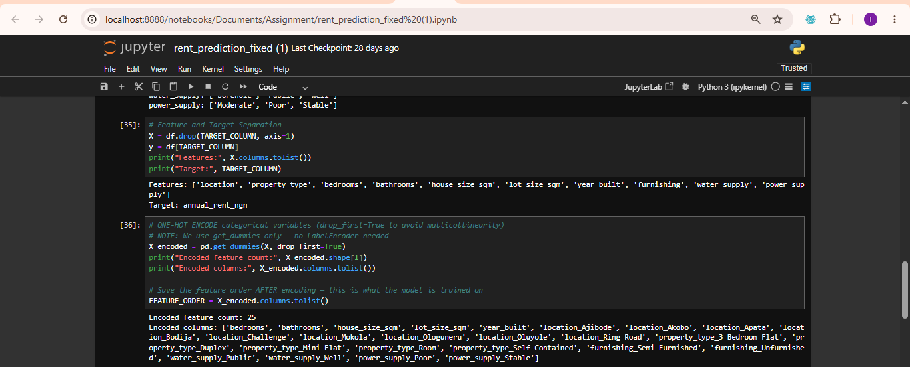
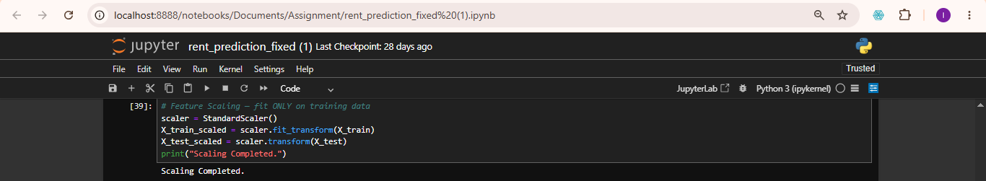
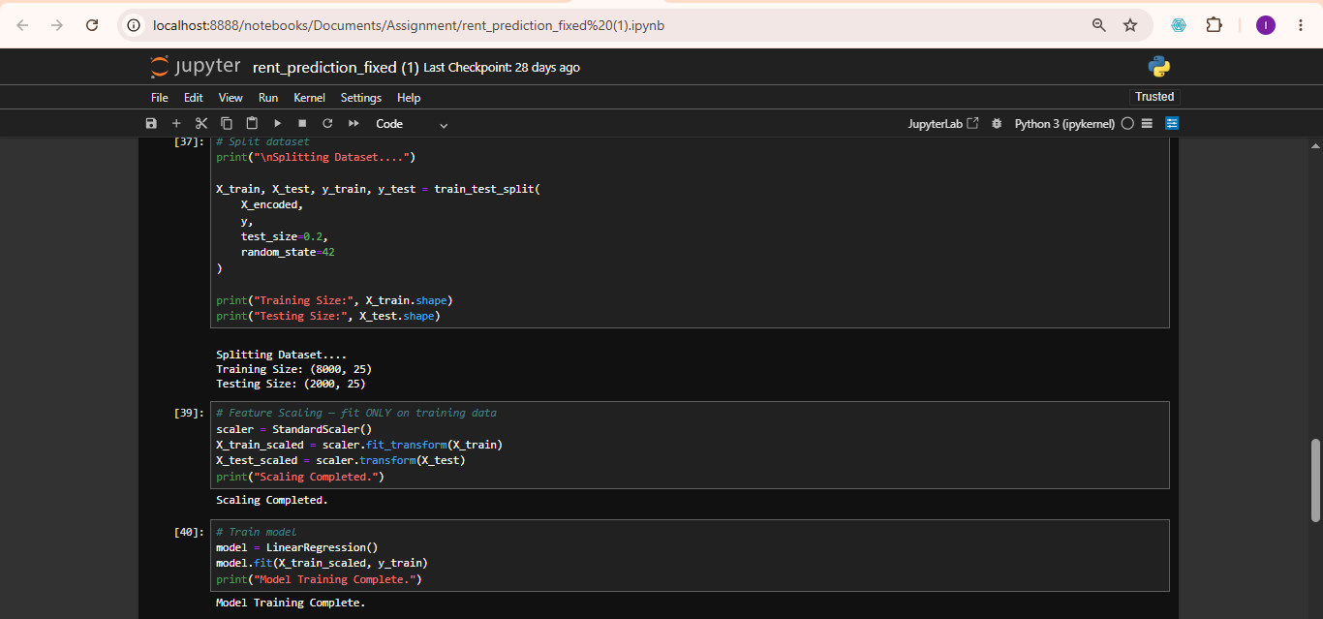
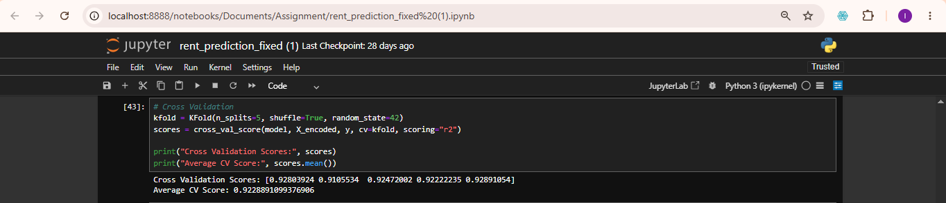
Data Preprocessing & Analysis – Encoding, Scaling & Training
Fig. 4.3 – Label Encoding (One-Hot Encoding, 25 encoded features)
Fig. 4.4 – Feature Scaling (StandardScaler)
Fig. 4.5 – Model Training (Linear Regression, 8000 train / 2000 test)
Fig. 4.6 – K-Fold Cross-Validation Scores: [0.9280, 0.9106, 0.9247, 0.9222, 0.9289] — Avg: 0.9229

Slide 8
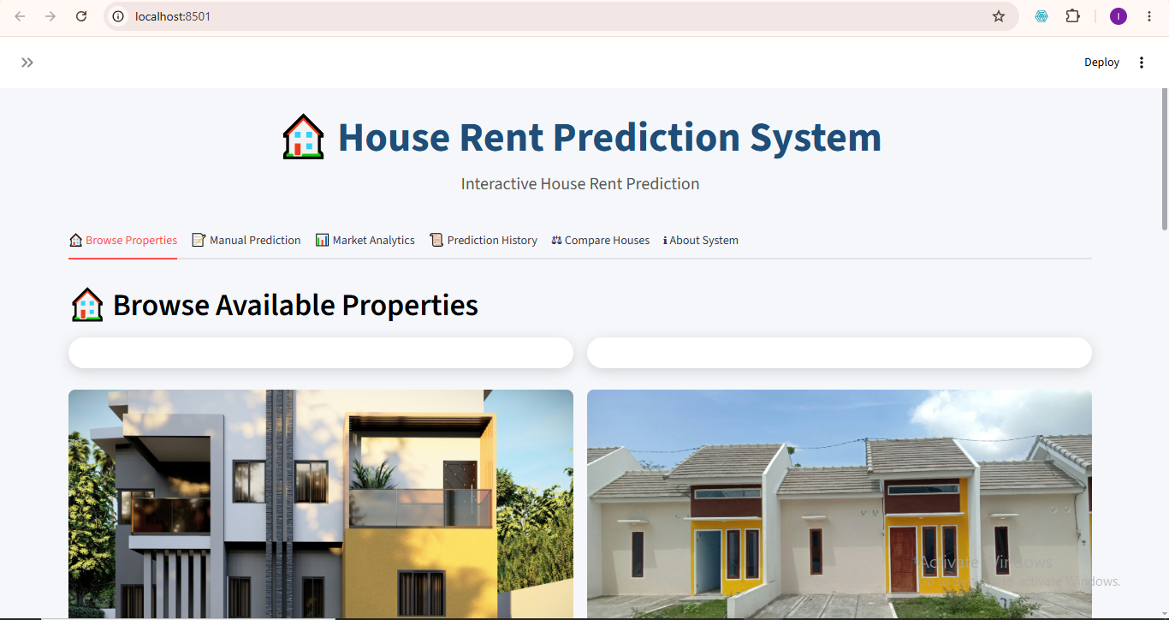
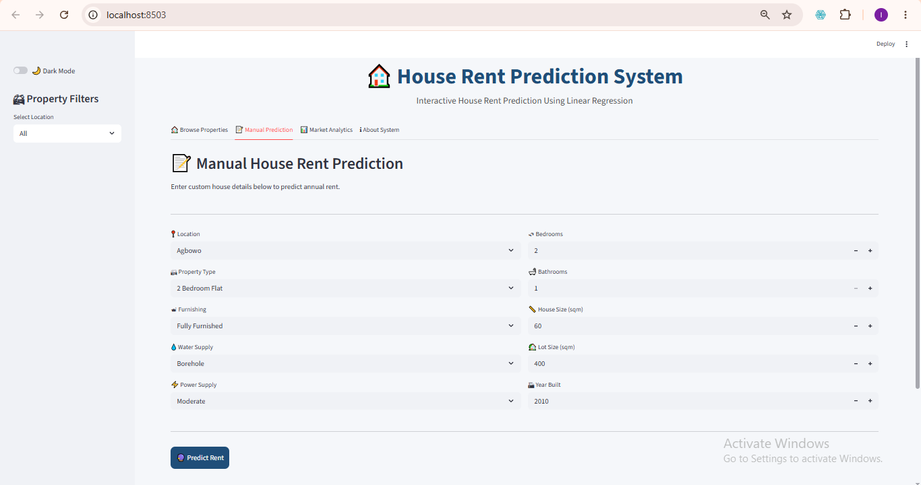
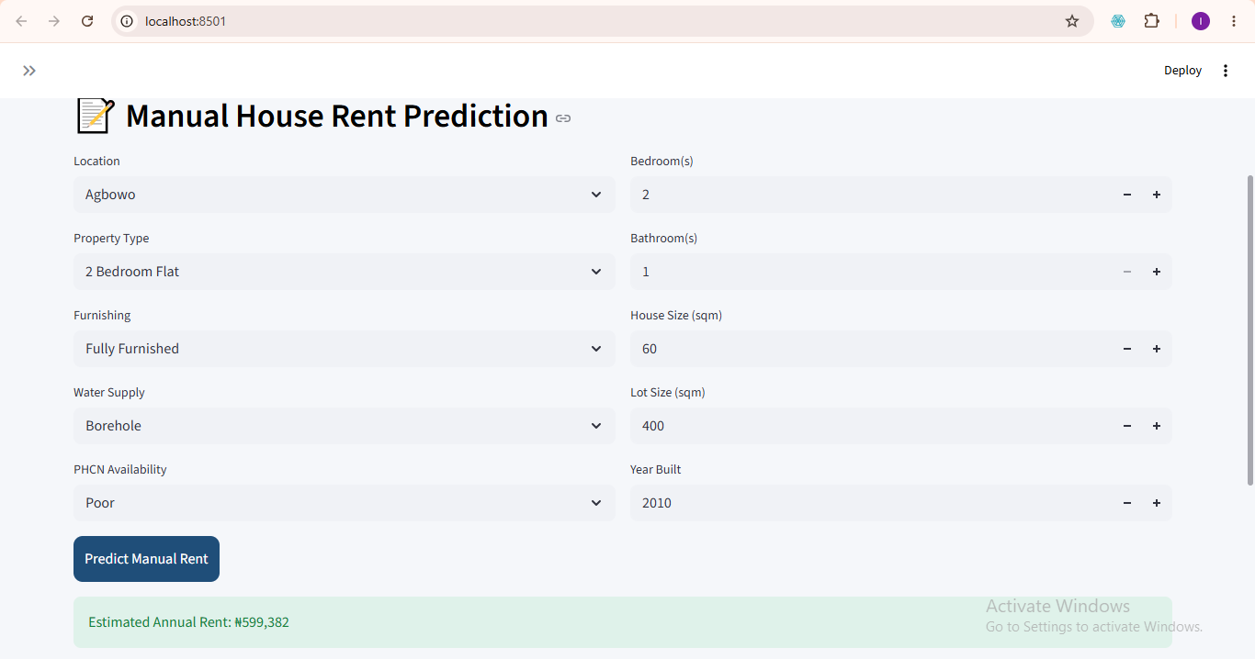
System Interface – Home & Manual Prediction
Figure 4.7 – Manual Prediction Interface
Figure 4.1 – Home Interface (Browse Properties)
Figure 4.8 – Prediction Output (Est. Annual Rent: ₦599,382)

Slide 9
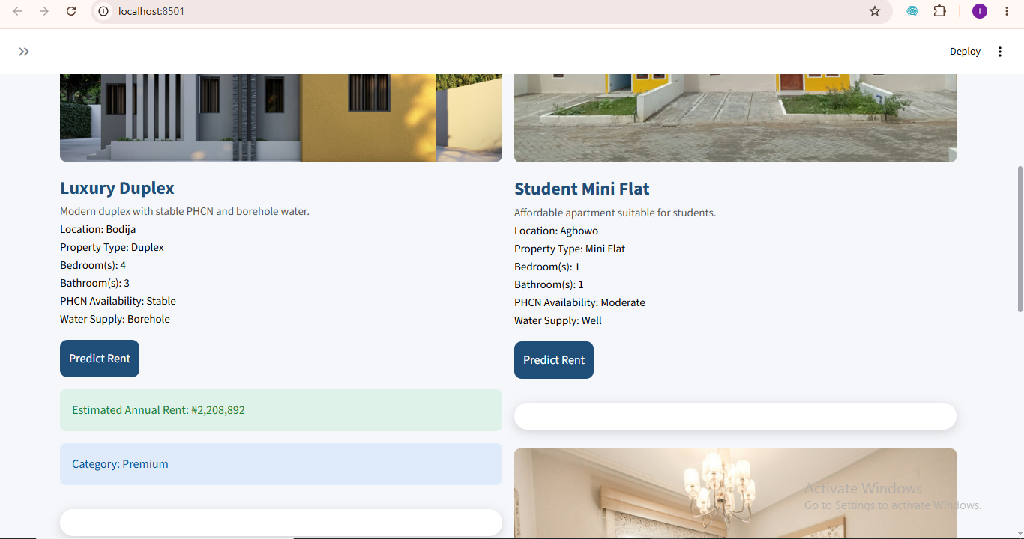
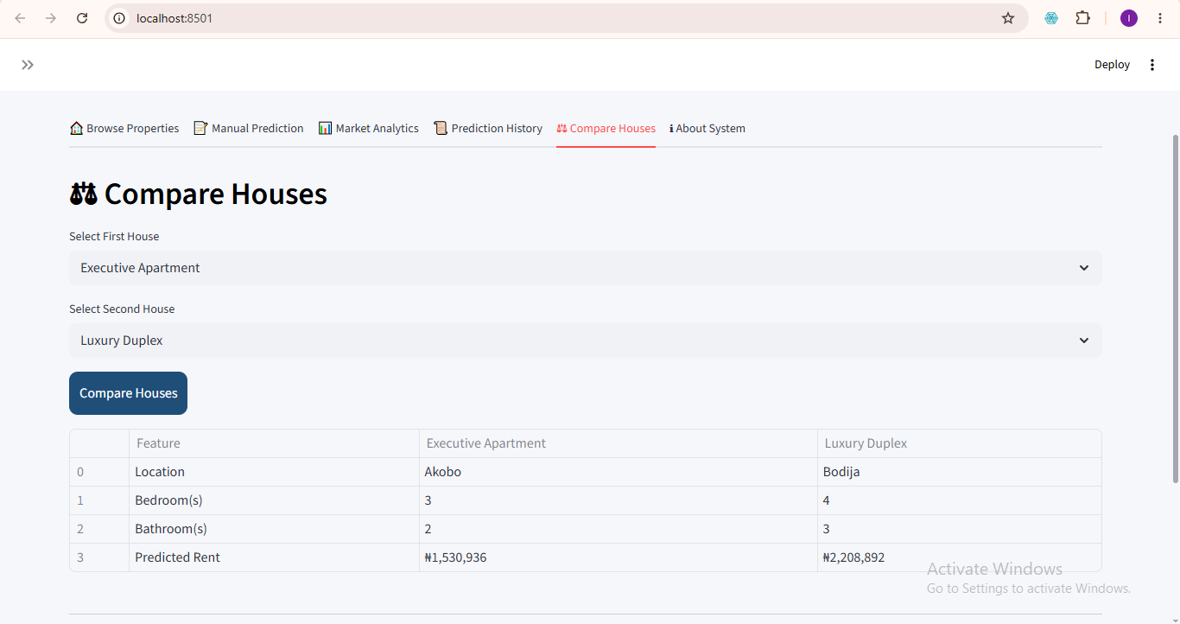
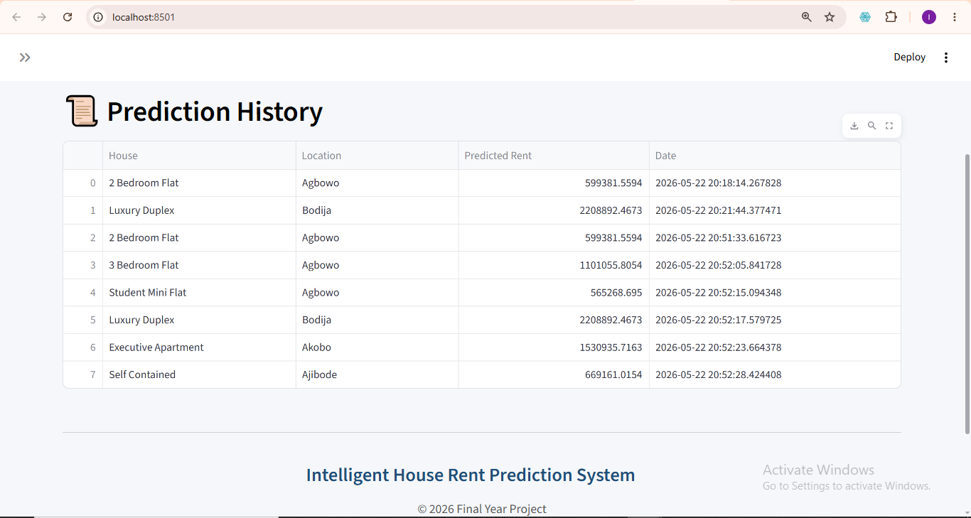
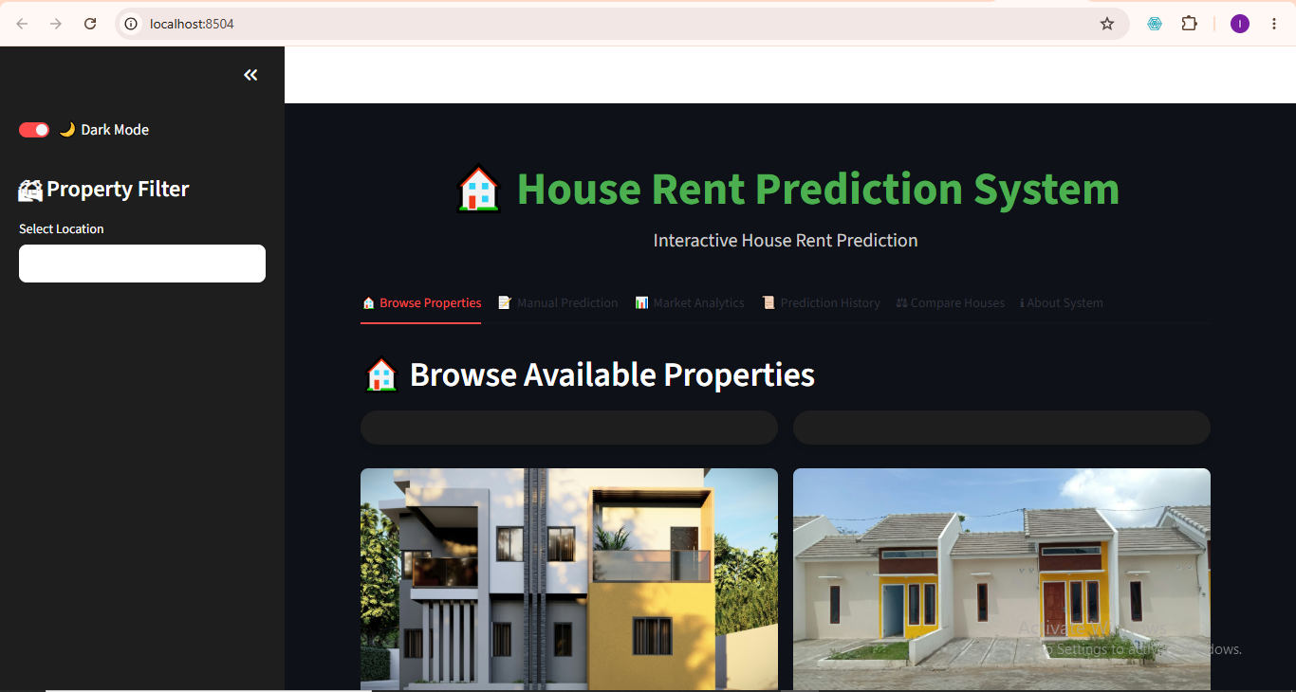
System Interface – Property Gallery, Comparison & History
Figure 4.9 – Property Gallery Interface
Figure 4.10 – House Comparison Interface
Figure 4.11 – Prediction History Interface
Figure 4.12 – Dark Mode Interface

Slide 10
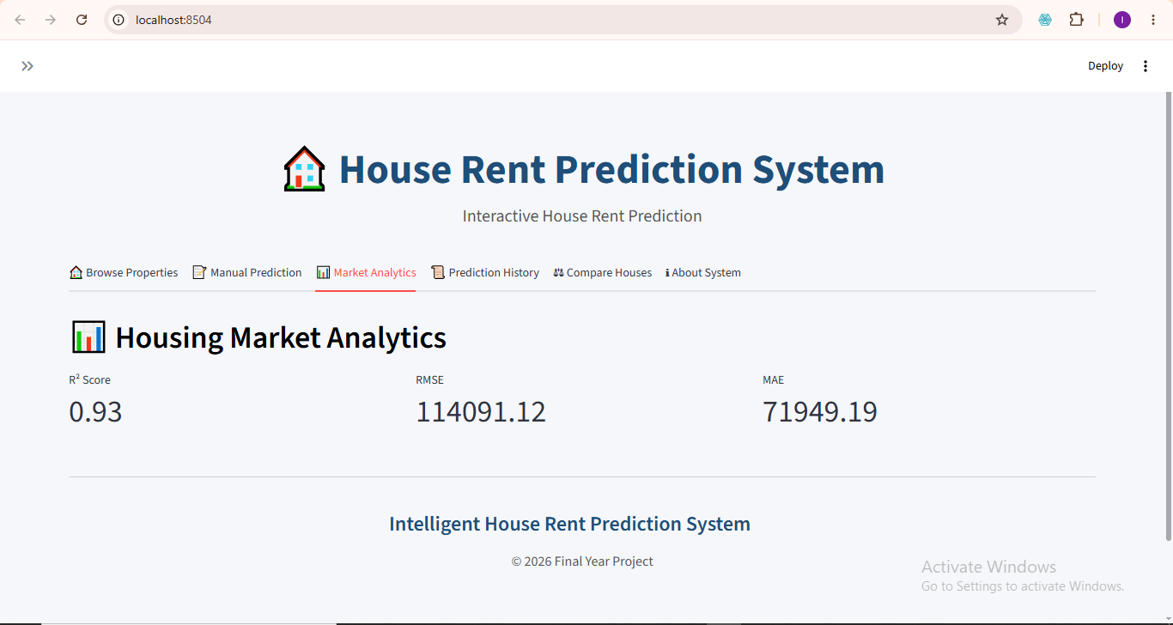
System Interface – Market Analytics
Figure 4.8 – Market Analytics Interface (R²: 0.93 | RMSE: ₦114,091 | MAE: ₦71,949)

Slide 11
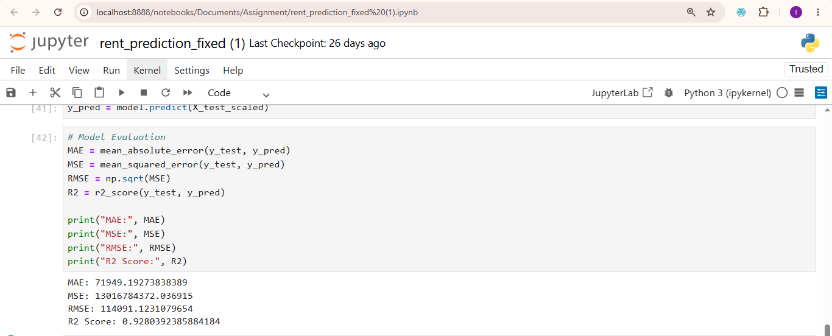
Model Evaluation Results
R² Score
MAE
RMSE
K-Fold Avg
92.8%
₦71,949
₦114,091
92.49%
Fig. 4.13 – Model Evaluation Output (MAE, MSE, RMSE, R² Score)
Fig. 4.6 – K-Fold Cross-Validation Scores
Functional:
✓ Pass
Input Validation:
✓ Pass
Integration:
✓ Pass
Performance:
✓ Pass

Slide 12
Conclusion & Recommendations
Contributions
Recommendations
Localized rent prediction model for Ibadan
Explore advanced models (Random Forest, XGBoost)
Integrated ML with interactive Streamlit UI
Expand dataset coverage to more cities
Combined agent data with secondary datasets
Integrate GIS for map-based visualization
Applied K-Fold validation for reliability
Include socio-economic variables
Introduced visual property exploration
Connect to real-time housing platforms

Slide 13
Thank You
Questions & Discussion
Rotimi Israel Taye
Matric No: E047849 | B.Sc Computer Science
Supervisor: Mr. O. A. Abiola | University of Ibadan, 2024–2025
Live App: https://house-rent-prediction-uljdjqbdnwkaefjfdccnqc.streamlit.app

